Slide 1
Collaborative Filtering & Data Mining
Jiawei Han and Micheline Kamber
Matrix Factorization Techniques For
Recommender Systems
Yehuda Koren, Robert Bell, Chris Volinsky
2009 IEEE Computer Society
Large-Scale Parallel Collaborative Filtering for the Netflix Prize
Yunhong Zhou, Dennis Wilkinson, Robert Schreiber, Rong Pan
LNCS 5034, pp. 337–348, 2008.

Slide 2
Motivation
User Perspective
Lots of online products, books, movies, etc.
Reduce my choices…please…
Manager Perspective
“ if I have 3 million customers on the web, I should have 3 million stores on the web.”
CEO of Amazon.com [SCH01]

Slide 3
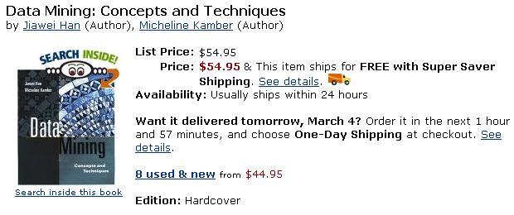
Example: Recommendation
Customers who bought this book also bought:
Data Preparation for Data Mining: by Dorian Pyle (Author)
The Elements of Statistical Learning: by T. Hastie, et al
Data Mining: Introductory and Advanced Topics: by Margaret H. Dunham
Mining the Web: Analysis of Hypertext and Semi Structured Data

Slide 4
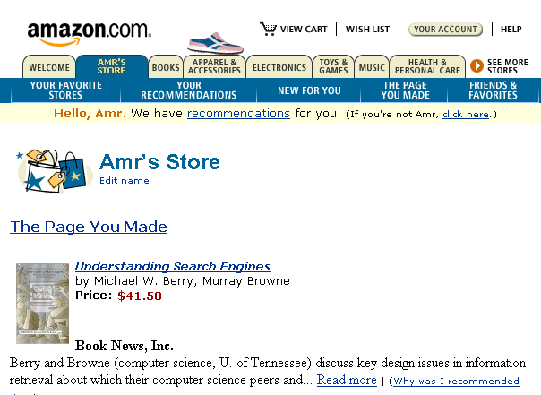
Example: Personalization

Slide 5
Other Examples
Movielens: movies
Moviecritic: movies again
My launch: music
Gustos starrater: web pages
Jester: Jokes
TV Recommender: TV shows
Suggest 1.0 : different products
And much more…

Slide 6
How it Works?
Each user has a profile
Users rate items
Explicitly: score from 1..5
Implicitly: web usage mining
Time spent in viewing the item
Navigation path
Etc…
System does the rest, How?
This is what we will show today

Slide 7
Basic Approaches
Collaborative Filtering (CF)
Look at users collective behavior
Look at the active user history
Combine!
Content-based Filtering
Recommend items based on key-words
More appropriate for information retrieval
Today’s
Focus

Slide 8
Collaborative Filtering: A Framework
Items: I
i₁ i₂ … i_{j} … i_{n}
3 1.5 …. … 2
₂
₁
₃
u₁
u₂
…
u_{i}
...
u_{m}
The task:
Q1: Find Unknown ratings?
Q2: Which items should we recommend to this user?
.
.
.
r_{ij}=?
Users: U
Unknown function
f: U x I→ R

Slide 9
Collaborative Filtering Road Map
User-User Methods
Identify like-minded users
Memory-based: K-NN
Model-based: Clustering
Item-Item Method
Identify buying patterns
Correlation Analysis
Linear Regression
Belief Network
Association Rule Mining

Slide 10
User-User Similarity: Intuition
Target
Customer
3
Q3: How to combine?
Q1: How to measure similarity?
Q2: How to select neighbors?

Slide 11
How to Measure Similarity?
i₁ i_{n}
Pearson correlation coefficient
Cosine measure
Users are vectors in product-dimension space
u_{a}
u_{b}

Slide 12
Nearest Neighbor Approaches [SAR00a]
Offline phase:
Do nothing…just store transactions
Online phase:
Identify highly similar users to the active one
Best K ones
All with a measure greater than a threshold
Prediction
User b’s deviation
User a’s neutral
User a’s estimated deviation

Slide 13
Clustering [BRE98]
Offline phase:
Build clusters: k-mean, k-medoid, etc.
Online phase:
Identify the nearest cluster to the active user
Prediction:
Use the center of the cluster
Weighted average between cluster members
Weights depend on the active user
Faster
Slower but a little more accurate

Slide 14
Clustering vs. k-NN Approaches
K-NN using Pearson measure is slower but more accurate
Clustering is more scalable
Active user
Bad recommendations
We can use soft clustering but will lose computational edge

Slide 15
Did We Answer the Questions?
Target
Customer
3
Q3: How to combine?
Q1: How to measure similarity?
Q2: How to select neighbors?

Slide 16
Are We Done?
Q1:How to measure similarity?
Done...
Really??
Sparsity results from the poor representation!
U1 rates recycled letter pads High
U2 rates recycled memo pads High
Both of them like Recycled office products
They are similar but the math won’t work for that
Example from [SAR00P]
What about Sparsity?
Not enough common Items
implies spurious neighbors
and hence bad recommendations
By working at the right level of abstraction we can eliminate sparsity

Slide 17
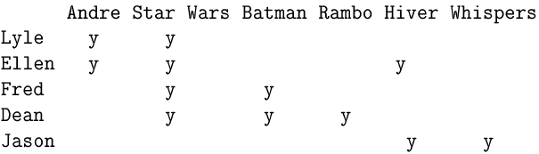
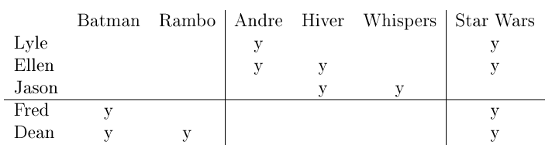
The Power of Representation [UNG98]
Action
Foreign
Classic
Q1-B: How can we formalize this intuition?

Slide 18
How to Abstract?
Semi-manual Methods
Use product features
Cluster products first, then cluster users
Works only if we have descriptive features
Automatic Methods
Adjusted Product Taxonomy
Latent Semantic Indexing

Slide 19
Latent Semantic Indexing [SAR00b]
=
I’
S
I_{k}’
R
U_{k}
S_{k}
R_{k}
U
r X n
m X k
k X n
m X r
r X r
m X n
k X k
The reconstructed matrix R_{k} = U_{k}.S_{k}.I_{k}’ is the closest
rank-k matrix to the original matrix R.
Captures latent associations
Reduced space is less-noisy

Slide 20
Are We Done? (2)
Not adequately answered
Q2:How to Select Neighbors?
We don’t expect to use the same neighbors for all products
Neighbors should be product-category specific

Slide 21
Are We Done? (3)
Q3:How to combine?
Weighted average
Discover association rules in neighbors’ transactions [LEE01, WAN04]
For every x in this group:
like(x, Item1) ^ like(x, Item2)→ like(x, Item3)
Use confidence and support to judge the quality of the prediction
Prediction is done on the binary level (like, dislike)
Costly to run online

Slide 22
User-User Methods Evaluation
Achieve good quality in practice
The more processing we push offline, the better the method scale
However:
User preference is dynamic
High update frequency of offline-calculated information
No recommendation for new users
We don’t know much about them yet

Slide 23
Collaborative Filtering Road Map
User-User Methods
Identify like-minded users
Memory-based: K-NN
Model-based: Clustering
Item-Item Method
Identify buying patterns
Correlation Analysis
Linear Regression
Association Rule Mining

Slide 24
Item-Item Similarity: The Intuition
Search for similarities among items
All computations can be done offline
Item-Item similarity is more stable that user-user similarity
No need for frequent updates
First Order Models
Correlation Analysis
Linear Regression

Slide 25
Correlation-based Methods [SAR01]
Same as in user-user similarity but on item vectors
Pearson correlation coefficient
Look for users who rated both items
Adjusted Cosine
i₁ i_{i} i_{j} i_{n}
u₁
u_{m}

Slide 26
Correlation-based Methods (2)
Offline phase:
Calculate n(n-1) similarity measures
For each item
Determine its k-most similar items
Online phase:
Predict rating for a given user-item pair as a weighted sum over similar items that he rated
U_{a}
2
3
?
4
j

Slide 27
Regression Based Methods [VUC00]
Offline phase:
Fit n(n-1) linear regressions
F_{ij}(x) is a linear transformation of a user rating on item i to his rating on item j
Online phase
Same as previous method
The weights are inversely proportional to the regression error rates

Slide 28
Association Rule Mining
Offline processing
Work on the binary level (like, dislike)
View user as market basket containing items liked by user
Discover association rules between items
Online processing:
Match items that the active user like with rules left hand side
Recommend rules’ consequent based on support and confidence

Slide 29
Matrix Factorization Techniques For Recommender Systems
Yehuda Koren, Robert Bell, Chris Volinsky
2009 IEEE Computer Society

Slide 30
Recommender System Strategies
Retailers interest in recommender systems, e.g. Amazon, Netflix
Based on one of two strategies or hybrid:
Content filtering
Create a profile for each user or product to characterize.
Require external information .
Collaborative filtering
Analyzes relationships between users and products to find new user-item associations.
Rely only on past user behavior.

Slide 31
Collaborative filtering
Neighborhood methods:
Center on computing the relationships between items or between users.
Item-oriented approach
A product and its neighbors get similar rating by same user.
User-oriented approach
Identifies like-minded user who can complement each other’s ratings.

Slide 32
Collaborative filtering
Latent factor models:
Explain the rating by characterizing both items and users on 20 – 100 factors inferred from the ratings patterns.
These factors are in general not obvious
Hard to estimate their impact on the ratings.
For user, each factor measures how much the user likes movies that corresponding movie factors.
The goal :to deduct the factors by using mathematical techniques.

Slide 33
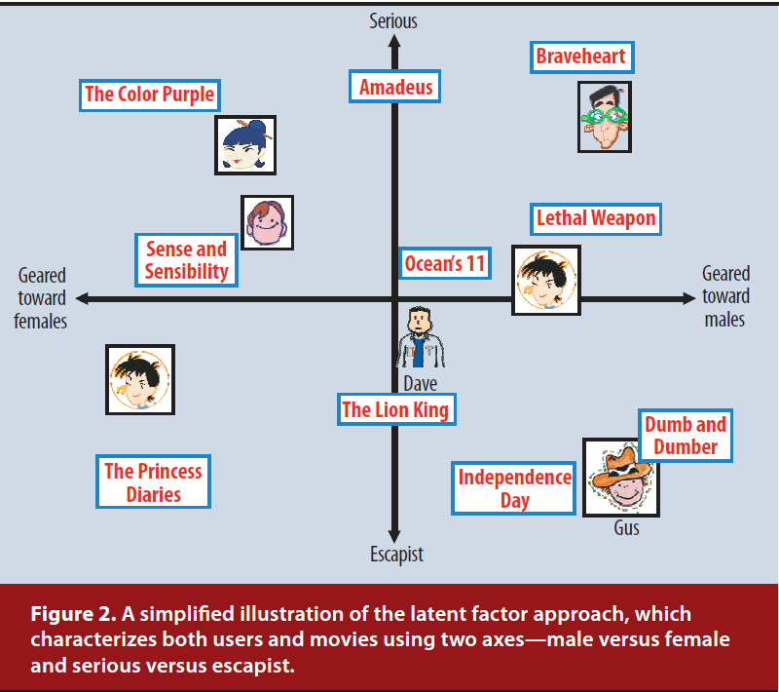

Slide 34
Some Problems Need to be solved
Data sparsity problem:
Solve by Stochastic gradient descent
Cold start problem:
Content-filter is superior.
Need to Improve recommendation accuracy
Collaborative filtering is superior.
Notes:
BPMF:
Cold start problem:
Solve by Social relation among user(
Need to Improve recommendation accuracy
Solve by item content

Slide 35
Matrix Factorization Methods
Characterizes both items and users by vectors of factors inferred from item rating patterns.
High correspondence -> recommendation
High-quality explicit feedback
By users regarding their interest in item -> rating.
A sparse matrix .
Implicit feedback:
Indirectly reflects opinion by observing user behavior.
Usually denotes the presence or absence of an event.
Densely filled matrix

Slide 36

A Basic Matrix Factorization Model
Joint latent factor space :
f - dimension space of users and items.
Definition:
Each item i : , positive or negative.
Each user u : , positive or negative.

Slide 37

A Basic Matrix Factorization Model
User-item interactions:
As inner product:
The user’s overall interest in the item’s characteristics , .
Approximates user u’s rating of item i ,

Slide 38

A Basic Matrix Factorization Model
To learn the factor vectors, Minimizes the squared error on the set of known ratings:
(2)
K : the set of (u, i) pairs for rui.
λ : control the extent of regularization and determined
by cross-validation
Avoid overfitting by adding the penalized value of quadratic regularized parameters.

Slide 39


Stochastic gradient descent
A gradient descent optimization method for minimizing an objective function.
Gradient descent:

Slide 40
Stochastic gradient descent
Simon Funk, 2006:
http://sifter.org/~simon/journal/20061211.html
Popularized a stochastic gradient descent optimization of Eq.(2).

Slide 41


Stochastic gradient descent
Objective function:
Modifies the parameters by a magnitude proportional to γ.

Slide 42
Alternating least squares
Both qi and pu are unknowns.
Eq. 2 is not convex.
If fix one of them, Eq. 2 becomes quadratic.
Rotate between fixing qi’s and fixing pu’s
All one of both are fixed, recomputed another by solving a least-squares problem.

Slide 43
Alternating least squares
In general , S.G.D. is easier and faster than ALS.
But, ALS is better in at least two case:
First, system can use parallelization.
In ALS , The computation of both are independent.
Second, systems centered on implicit data.
The training set cannot be considered sparse.

Slide 44
Adding Biases
MF approach has flexibility due to Eq. 1.
but has some biases or intercepts, independent of any interactions.
Try to identify the portion of true interaction with individual user and item biases.

Slide 45

Adding Biases
A first-order approximation of the bias :
(3)
bui : the bias involved in rating rui .
μ : average rating over all movies.
bi , bu : the observed deviation of user u and item i.

Slide 46

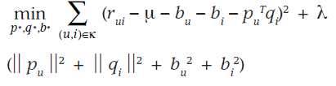
Adding Biases
Extend Eq. 1. :
(4)
System learns by minimizing the squared error function:
(5)

Slide 47
Additional Input Sources
Back to the cold start problem:
Some users supply very few ratings.
Difficult to deduce their preference.
Incorporate additional sources of information about users:
Using the Implicit feedback

Slide 48



Additional Input Sources
Boolean implicit feedback:
N(u) , the set of items for which user u expressed an implicit preference.
A new set of item factors
User can be characterized by the vector:
,
Normalizing form :

Slide 49



Additional Input Sources
Another information source - user attribute
A(u), the set of attribute corresponds to user u.
e.g. age, gender, income level … etc.
User can also be characterized by the vector:
,
We can integrate all signal sources:
(6)

Slide 50
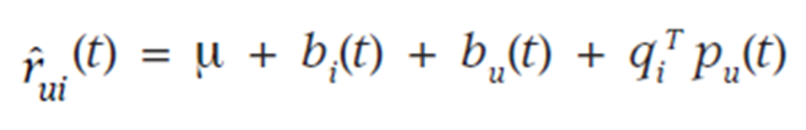
Temporal Dynamics
Decomposing ratings into distinct terms:
Item biases, bi(t):
Item’s popularity might change over time.
User biases, bu(t).
User change their baseline rating over time.
User preference, pu(t)
User change their preference over time.

Slide 51
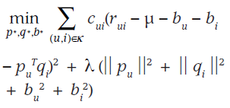
Inputs with Varying Confidence Level
Not all observed ratings deserve the same weight or confidence.
Advertising might influence votes for certain items.
Systems built around implicit feedback.
Model enhance the Eq. 5. to account for confidence:
Collaborative Filtering for Implicit Feedback

Slide 52
Related Extension
PMF – Probabilistic Matrix Factorization
BPMF – Bayesian Probabilistic Matrix
Factorization
GPMF – General Probabilistic Matrix Factorization
BPMFSRIC – Bayesian Probabilistic Matrix
Factorization with Social Relations
and Item contents

Slide 53
Large-Scale Parallel Collaborative Filtering for the Netflix Prize
Yunhong Zhou, Dennis Wilkinson, Robert Schreiber, and Rong Pan
LNCS 5034, pp. 337–348, 2008.

Slide 54
Abstract
Many recommendation systems suggest items to users by utilizing the techniques of collaborative filtering.
Two major problems that most CF approaches have to contend with are scalability and sparseness of the user profiles.
In this paper, we describe a CF algorithm alternating-least-squares with weighted-λ-regularization (ALS-WR).
We achieved a performance improvement of 5.91% over Netflix’s own Cine-Match recommendation system.

Slide 55
Introduction(1/2)
The Netflix Prize is a large-scale data mining competition held by Netflix for the best recommendation system algorithm for predicting user ratings on movies, based on a training set of more than 100 million ratings given by over 480,000 users to 17,700 movies.
Each training data point consists of a quadruple (user, movie, date, rating) where rating is an integer from 1 to 5. The test dataset consists of 2.8 million data points with the ratings hidden.
The goal is to minimize the RMSE when predicting the ratings on the test dataset. Netflix’s own recommendation system scores 0.9514 on the test dataset, and the grand challenge is to improve it by 10%.

Slide 56
Introduction(2/2)
The Netflix problem presents a number of practical challenges.
The size of the dataset is 100 times larger than previous benchmark datasets, resulting in much longer model training time and much larger system memory requirements.
Only about 1% of the user-movie matrix has been observed, with the majority of (potential) ratings missing.
There is noise in both the training and test dataset, due to human behavior.
The distribution of ratings per user in the training and test datasets are different.

Slide 57






Problem Formulation(1/6)
Let ${R=\{r_{ij}\}}_{nu∗nm}$denote the user-movie matrix.
The Netflix dataset consists of $n_{m}$= 17770 movies, $n_{u}$ = 488000 users, and $n_{r}$ ≈ 100 million known ratings.
R
…
$$M_{j}$$
$$M_{1}$$
4 |  | 3
 | 2
1 | 5
 | 3
$$U_{1}$$
$$U_{2}$$
…
$$U_{n}$$

Slide 58
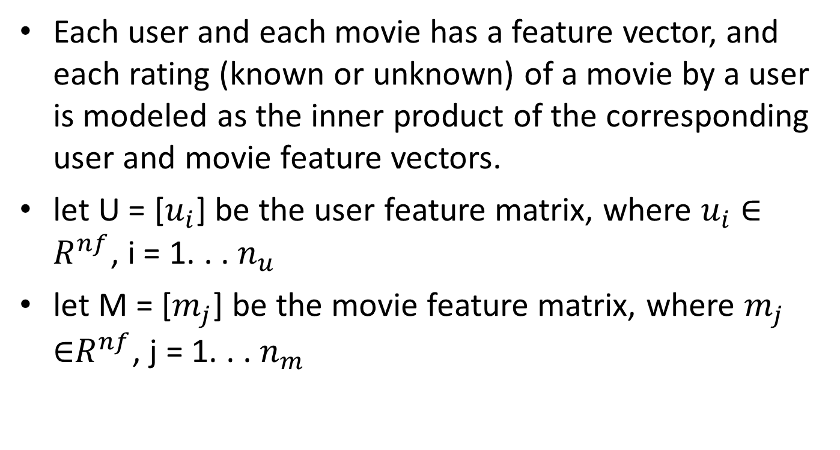
Problem Formulation(2/6)
Each user and each movie has a feature vector, and each rating (known or unknown) of a movie by a user is modeled as the inner product of the corresponding user and movie feature vectors.
let U = [$u_{i}$] be the user feature matrix, where $u_{i}$ ∈ $R^{nf}$, i = 1. . . $n_{u}$
let M = [$m_{j}$] be the movie feature matrix, where $m_{j}$ ∈$R^{nf}$, j = 1. . . $n_{m}$

Slide 59










Problem Formulation(3/6)
$$U_{1}$$
$$U_{2}$$
…
$$U_{n}$$
$$M_{1}$$
$$M_{2}$$
…
$$M_{j}$$
$$F_{1}$$
$$F_{1}$$
…
…
$$F_{k}$$
$$F_{k}$$
U: the user feature matrix
M: the movie feature matrix

Slide 60

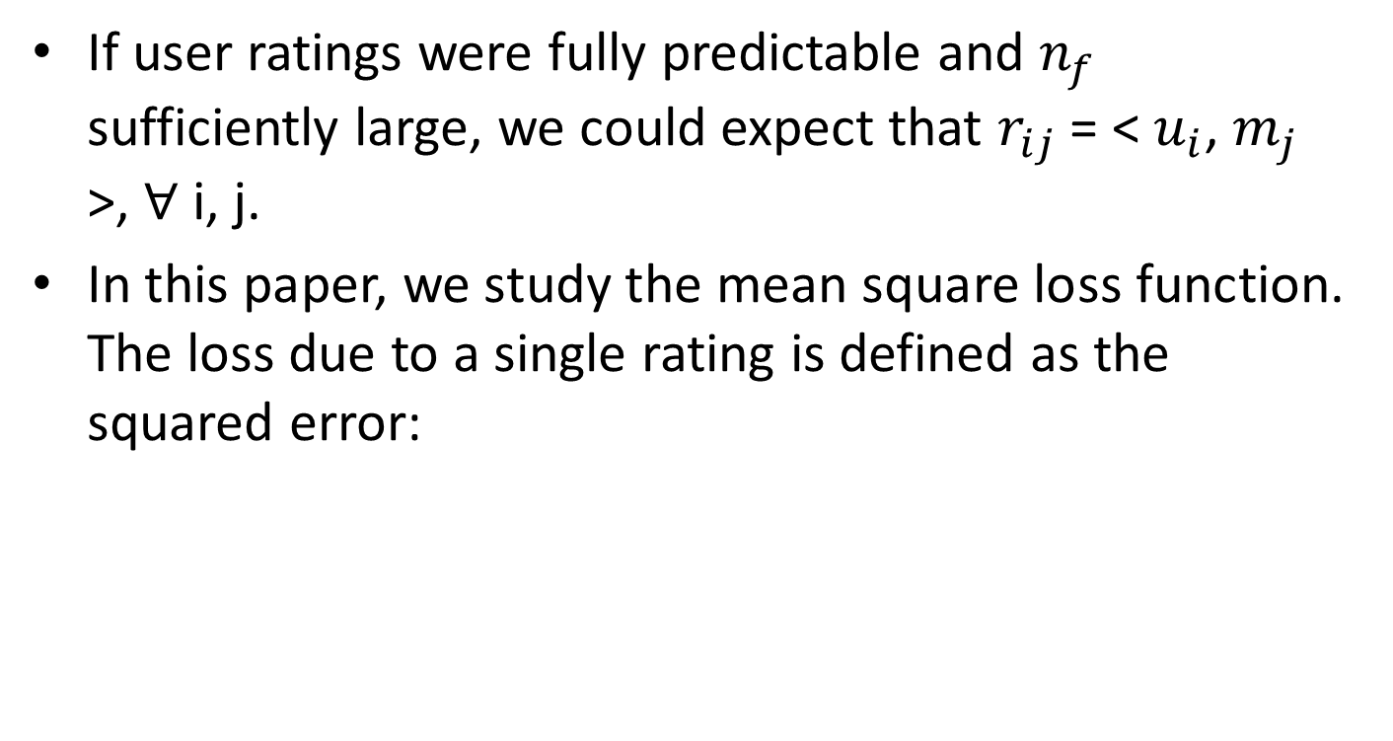
Problem Formulation(4/6)
If user ratings were fully predictable and $n_{f}$ sufficiently large, we could expect that $r_{ij}$ = < $u_{i}$, $m_{j}$ >, ∀ i, j.
In this paper, we study the mean square loss function. The loss due to a single rating is defined as the squared error:

Slide 61
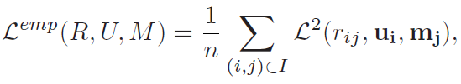

Problem Formulation(5/6)
Then we can define the empirical, total loss (for a given pair U and M) as the summation of loss on all the known ratings.
We can formulate the low-rank approximation problem as follows.

Slide 62

Problem Formulation(6/6)
When $n_{f}$ is relatively large, solving the problem overfits the data. To avoid overfitting, a common method appends a Tikhonov regularization term to the empirical risk function:

Slide 63
Approaches(1/5)
In this paper, we use alternating-least-squares (ALS) to solve the low-rank matrix factorization problem as follows:
Step 1. Initialize matrix M by assigning the average rating for that movie as the first row, and small random numbers for the remaining entries.
Step 2. Fix M, Solve for U by minimizing the objective function.
Step 3. Fix U, solve for M by minimizing the objective function similarly.
Step 4. Repeat Steps 2 and 3 until a stopping criterion is satisfied(If the change in RMSE is less than 0.0001).

Slide 64
















Approaches(2/5)
R
$$M_{1}$$
…
$$M_{j}$$
$$U_{1}$$
4 |  | 3
 | 2
1 | 5
 | 3
$$U_{2}$$
R$≈U^{T}M=\hat{R}$
…
$$U_{n}$$
U
M
$$U_{1}$$
$$U_{2}$$
…
$$U_{n}$$
$$M_{1}$$
$$M_{2}$$
…
$$M_{j}$$
$$F_{1}$$
$$F_{1}$$
…
…
$$F_{k}$$
$$F_{k}$$

Slide 65

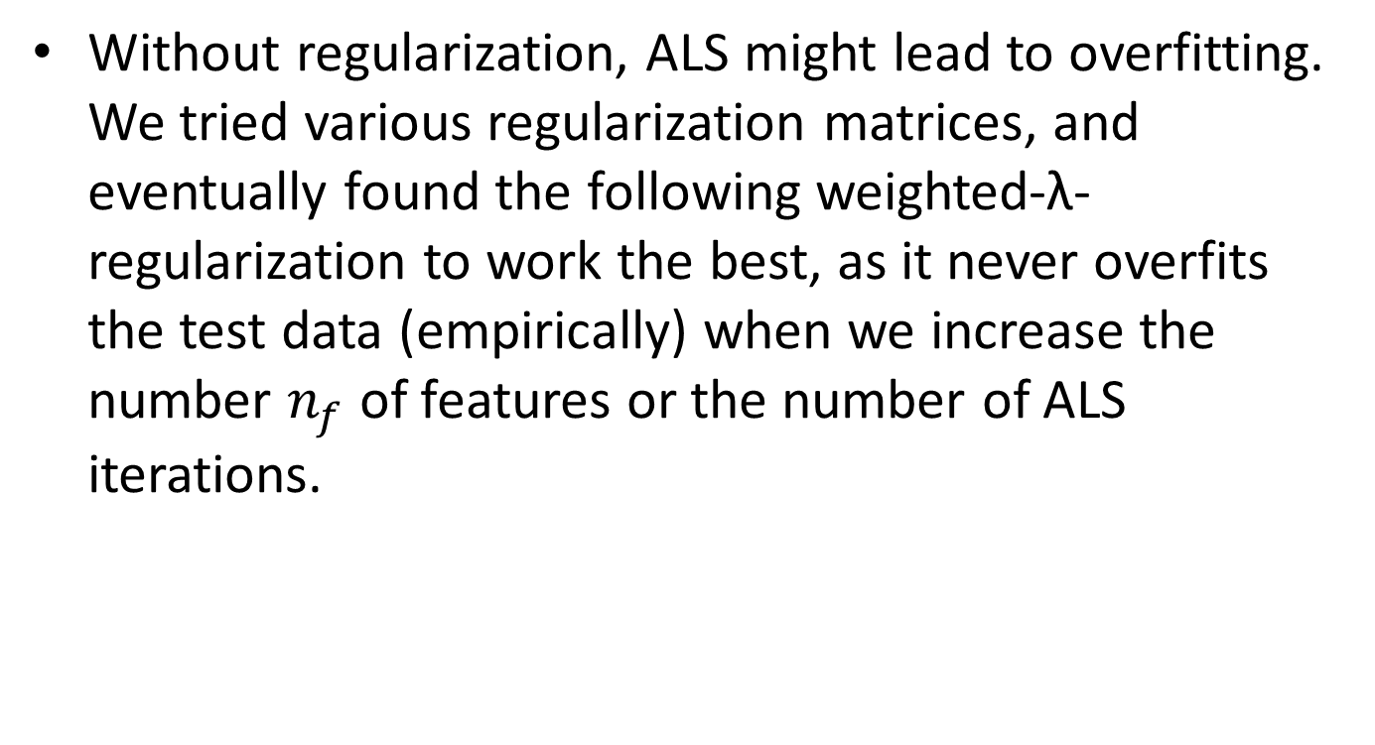
Approaches(3/5)
Without regularization, ALS might lead to overfitting. We tried various regularization matrices, and eventually found the following weighted-λ-regularization to work the best, as it never overfits the test data (empirically) when we increase the number $n_{f}$ of features or the number of ALS iterations.

Slide 66

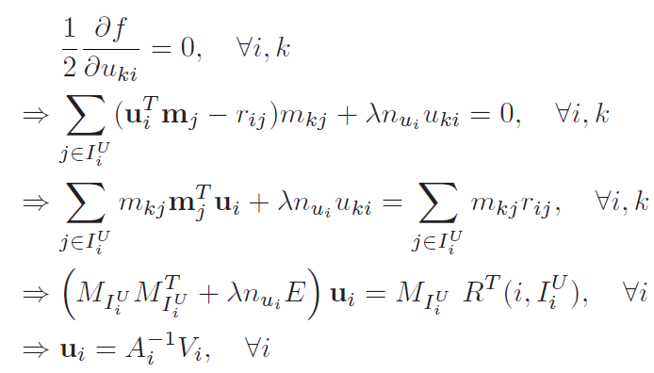


Approaches(4/5)
A given column of U, say $u_{i}$, is determined by solving a regularized linear least squares problem involving the known ratings of user i, and the feature vectors $m_{j}$ of the movies j ∈ that user i has rated.

Slide 67


Approaches(5/5)
Similarly, when M is updated, we can compute individual $m_{j}^{}$‘s via a regularized linear least squares solution, using the feature vectors of users who rated movie j, and their ratings of it, as follows:

Slide 68
Concluding Remarks
We introduced a simple parallel algorithm for large-scale collaborative filtering which, in the case of the Netflix prize, performed as well as any single method reported in the literature. Our algorithm is designed to be scalable to very large datasets.
ALS-WR in particular is able to achieve good results without using date or movie title information.
The fast runtime achieved through parallelization is a competitive advantage for model building and parameter tuning in general. It will be interesting to develop a theory to explain why ALS-WR never overfits the data.

